Slide 1
Countess Quanta Architecture

Slide 2
Why not use something like ROS?
Overly complex for our needs – would spend more time learning how to work around ROS quirks and limitations instead of implementing new features
Limited number of sensors and hardware – flexibility of ROS would not be an advantage
Harder to implement complex machine learning algorithms
Better performance in C# due to less overhead
Better scaling for machine learning with C#, since vast amounts of data can be queried in minimal time with an integrated enterprise-level indexed database
Easier for new students to pick up and learn
Official Kinect SDK not available on Ubuntu

Slide 3
Layer Diagram

Slide 4
Boot Sequence

Slide 5
State Machine

Slide 6
Decision Initializer

Slide 7
Decision Hierarchy

Slide 8
Making a Decision

Slide 9
Decision Interface

Slide 10
Action Example

Slide 11
Retrieving Actions

Slide 12
Running Actions

Slide 13
IAction Interface

Slide 14
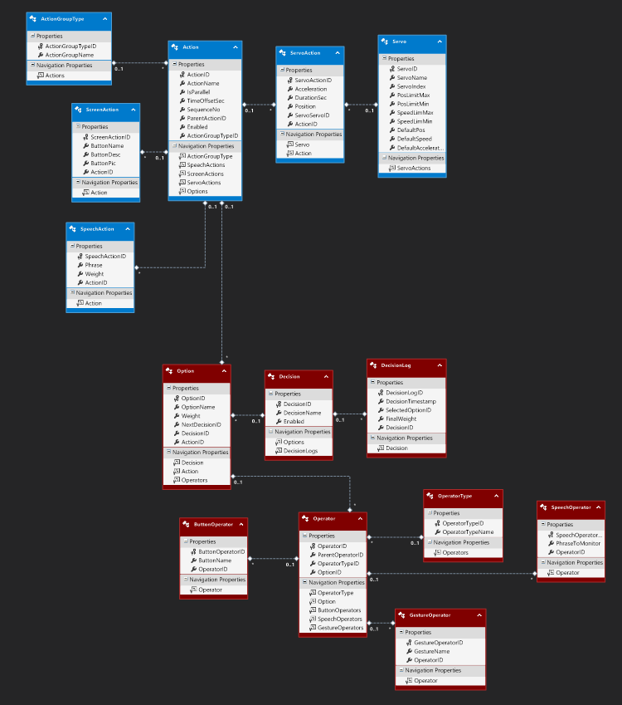
Database
Blue are Action tables
Red are Decision tables

Slide 15
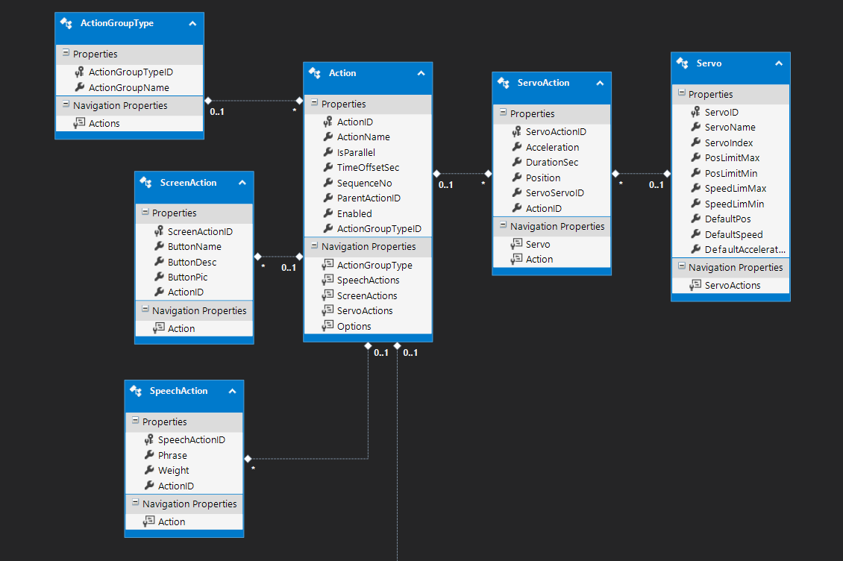
Action Tables

Slide 16
ActionType table
Specifies what kind of action the associated action (specified by “ActionID” is
“ParentAction” – Says that the action is a parent of one or more sub-actions
“ScreenAction” – Says that the action is linked to a screen activity
“SpeechAction” – Says that the action is linked to a speech activity
“ServoAction” – Says that the action is linked to a servo activity

Slide 17
ScreenAction
“ButtonName” is the name of the button displayed on the screen
“ButtonDesc” is a description of the button
“ButtonPic” is a picture displayed on the button

Slide 18
SpeechAction
“Phrase” – the phrase to say
“Weight” – allows the ability for a particular phrase to come up more/less often when ran through a randomizer algorithm

Slide 19
Servo
“ServoName” – the name of the servo
“ServoIndex” – the Polulu servo ID
“PosLimitMax” – the maximum position of the servo
“PosLimitMin” – The minimum position of the servo
“SpeedLimMax” – the maximum speed of the servo
“SpeedLimMin” – the minimum speed of the servo
“DefaultPos” – the default position of the servo
“DefaultSpeed” – the default speed of the servo
“DefaultAcceleration” – the default acceleration of the servo

Slide 20
ServoAction
“Acceleration” – specifies how fast the servo accelerates
“DurationSec” – specifies how long the servo is running
“Position” – specifies the ending position of the servo

Slide 21
Action
“ActionName” – The name of the action
“IsParallel” – specifies whether or not the action should be executed in parallel
“TimeOffsetSec” – how long to wait before firing the action
“SequenceNo” – the sequence number of the action, if the action is not parallel
“Enabled” – Specifies whether or not the action is enable – this allows for actions to be “deleted” without really deleting the actions or sub-actions, in the event the action needs to be re-enabled.

Slide 22
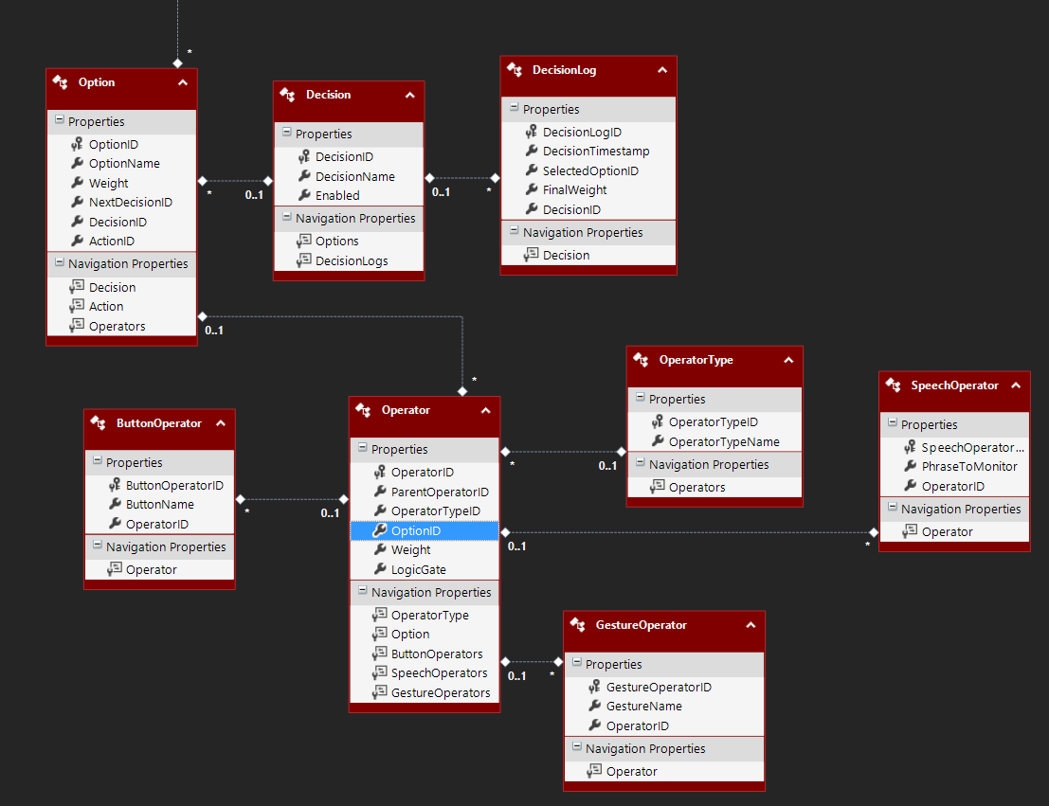
Decision Tables

Slide 23
Option
“OptionName” – the name of the option
“Weight” – the fuzzy logic weight assigned to the option
“NextDecisionID” – the ID of the decision to run if this option is chosen
“DecisionID” – the ID of the associated decision
“ActionID” – the ID of the action to run if the option is chosen

Slide 24
Decision
“DecisionName” – the name of the decision (for human readability)
“Enabled” – specifies whether or not the decision is enabled.

Slide 25
DecisionLog
This keeps a log of each decision that was made
“DecisionTimestamp” – The timestamp when the decision was made
“SelectedOptionID” – The option that was chosen
“FinalWeight” – The fuzzy logic weight of the final decision
“DecisionID” – the associated decisionID

Slide 26
OperatorType
OperatorTypeName – Name that determines what type the associated operator is
“ParentOperator” – says that there are children operators
“GestureOperator” – says that the operator is based on a gesture
“SpeechOperator” – says that the operator is based on a speech phrase
“ButtonOperator” – says that the operator is based on a button action
More options can be added, but additional tables will need to be added as well.

Slide 27
Operator
ParentOperatorID – the ID of the parent operator option
OptionID – the ID of the associated option
Weight – the fuzzy logic weight of the operator
LogicGate – only useful for operators of the “ParentOperator” type – specifies how to evaluate children operators – options are “AND”, “OR”, “NAND”, “NOR”, or “XOR”

Slide 28
ButtonOperator
ButtonName – the name of the button to monitor – if the button with the matching name is pushed, the operator returns “true”.

Slide 29
GestureOperator
GestureName – the name of the gesture to monitor

Slide 30
SpeechOperator
The name of the phrase to monitor

Slide 31
Resources
Subscribing to events (http://msdn.microsoft.com/en-us/library/ms366768.aspx )
Interfaces (http://msdn.microsoft.com/en-us/library/ms173156.aspx )
Entity Framework (http://msdn.microsoft.com/en-us/data/ee712907 )
Task Parallel Library (http://msdn.microsoft.com/en-us/library/dd460717(v=vs.110).aspx )

